Slide 1
Changes to the Business Unit Settlement Risk Rating (BUSRR) criteria
Public
Kat Gay
Paulina Stelmach

Slide 2
Agenda
Module 1: What are BUSRRs and why do we have them?
Module 2: PARMS BUSRRs
Module 3: Settlement BUSRRs
Module 4: Future impacts to the BUSRRs

Slide 3
WHAT are BUSRRs and WHY do we have them?

Slide 4
Performance Assurance Framework
Change
Management
Error & Failure
Resolution
Education
Disputes
Management
Entry Process
Testing
Supplier
Charges
Accreditation
& Certification
Peer
Comparison
Operational
Audit
Performance
Monitoring
Technical
Assurance
Delivered
via PARMS
Preventative
Detective
Corrective

Slide 5
PARMS
Performance Assurance Reporting and Monitoring System
Data Providers
Database
Reports
Supplier-Agent Statistics
SRR & Dashboard
Peer Comparison
Auto generated PARMS Reports
Supplier Charges
PARMS

Slide 6
Performance Assurance Board (PAB)
The PAB conducts and administers activities to provide assurance that all participants in the BSC arrangements are suitably qualified and that the relevant standards are maintained.
The PAB is appointed by, and reports to the BSC Panel.
PAB Responsibilities:
  SVA Qualification
  Technical Assurance
  Operational audit
  Liquidated Damages and Peer Comparison

Slide 7
What’s a BUSRR???
Risks measured at Business Unit (BU) Level
Risk Evaluation Register provides the top Settlement Risks (SR) with measureable data
The risk posed to Settlement by BUs by performing poorly is given a Rating (R) – RED, AMBER or GREEN
The risk ratings of each BU is reported to the PAB monthly
BU
SR
R

Slide 8
BUSRRs: April 2017 view

Slide 9
PARMS BUSRRs

Slide 10
SR3019
Data Quality (SR0022 and SR028 Combined)

Slide 11
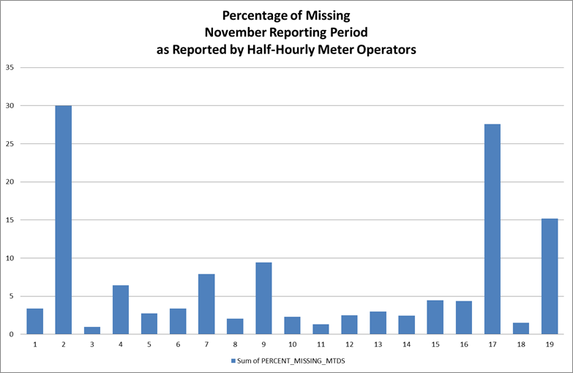
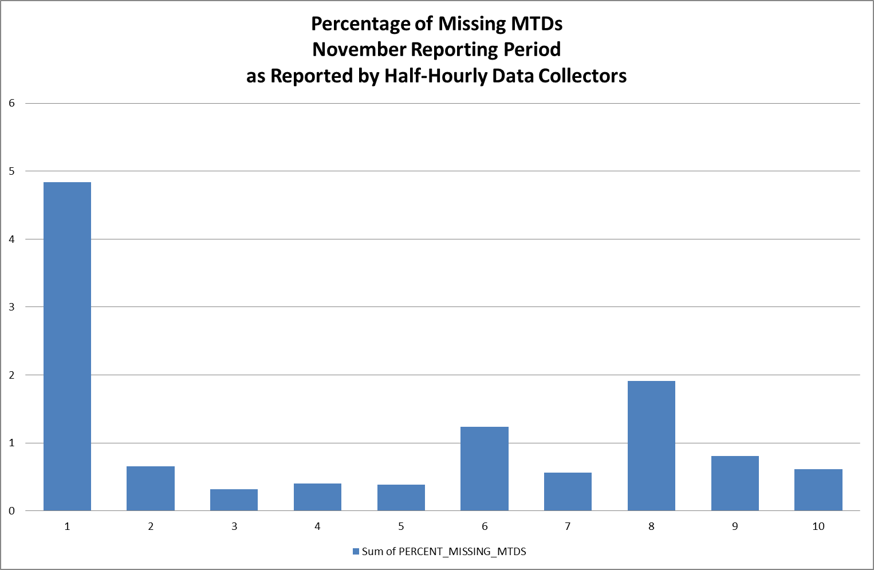
Peer Comparison – Now Public!

Slide 12
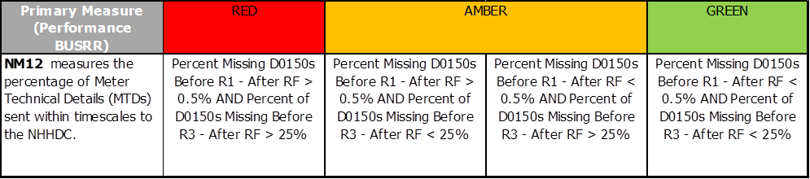
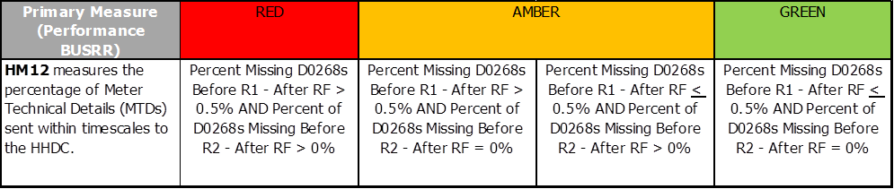
SR0024 & SR0025 - Missing Meter Technical Details (MTDs)
SR0024 – Missing NHH MTDs
SR0025 – Missing HH MTDs

Slide 13
Settlement BUSRRs
Notes:
Now going onto Settlement BUSRRs.

Slide 14
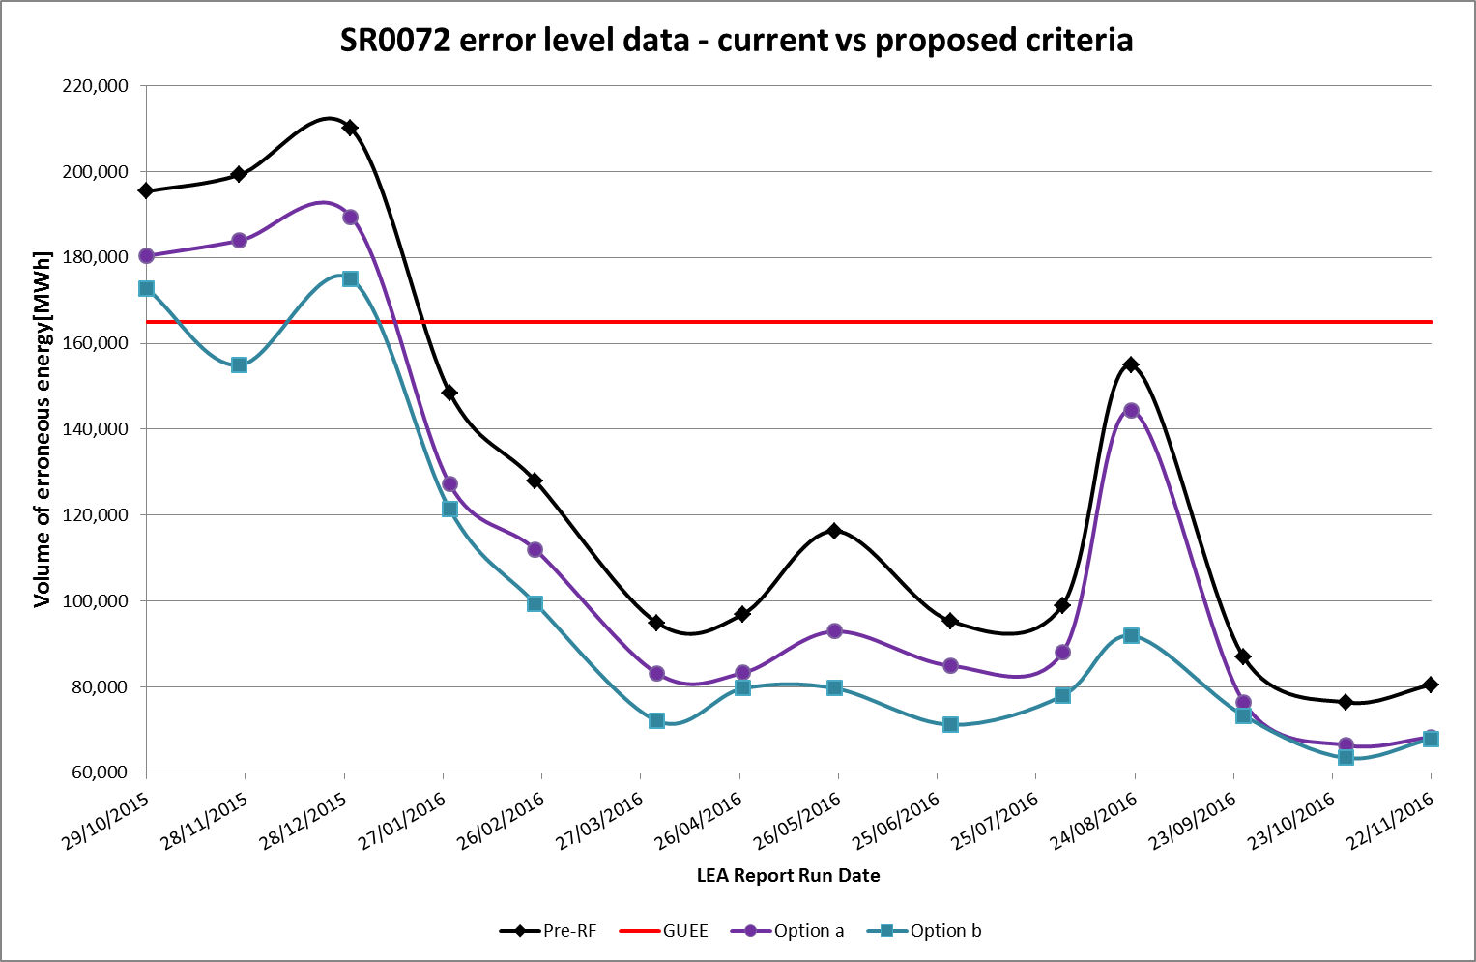
Settlement BUSRRs
Why change the SR72 criteria?

Slide 15
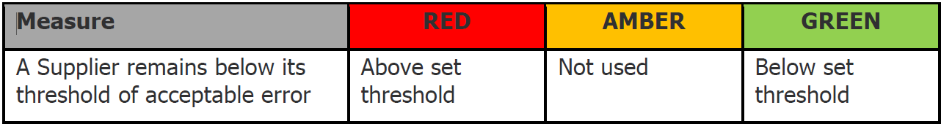
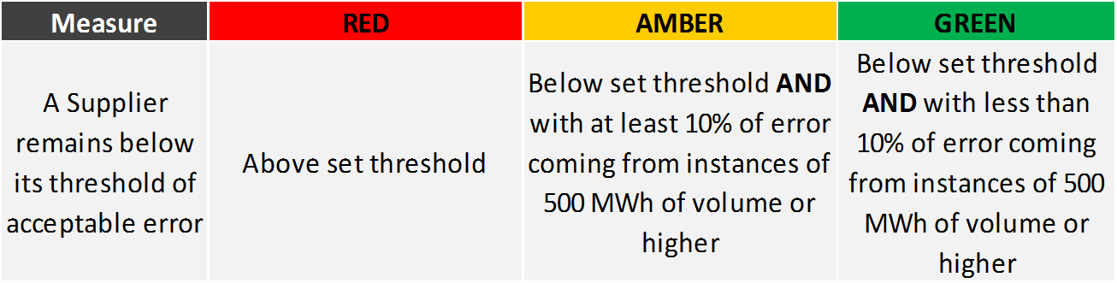
Settlement BUSRRs
SR0072 OLD:
SR0072 NEW:

Slide 16
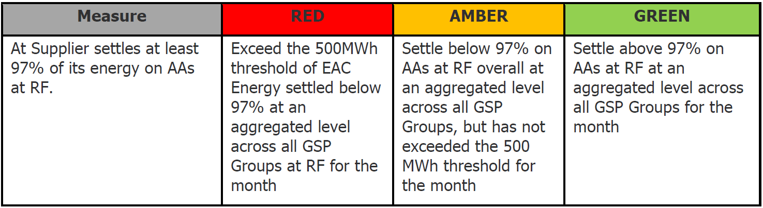
Settlement BUSRRs
SR0074 Old
SR0074 New

Slide 17
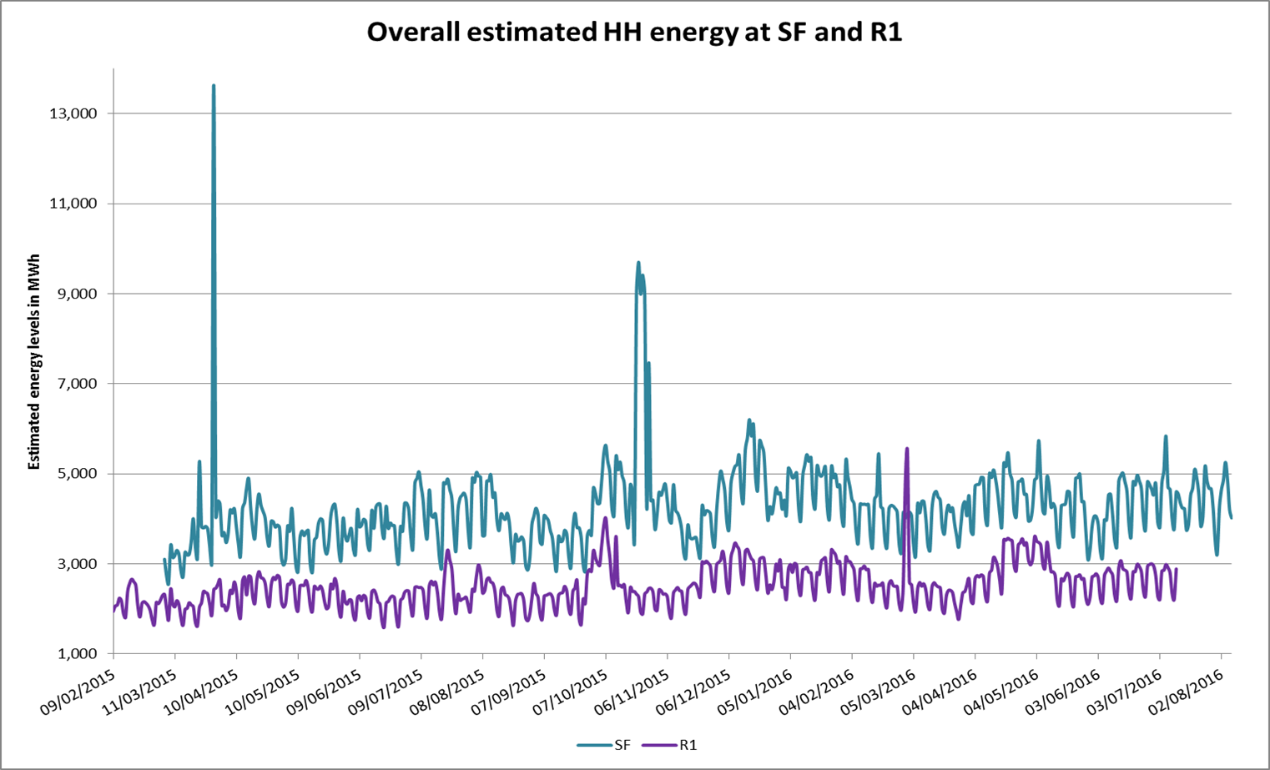
Settlement BUSRRs
Why Change SR0081?

Slide 18
Settlement BUSRRs
SR0081 (100kW) OLD:
SR0081 (100kW) NEW:

Slide 19
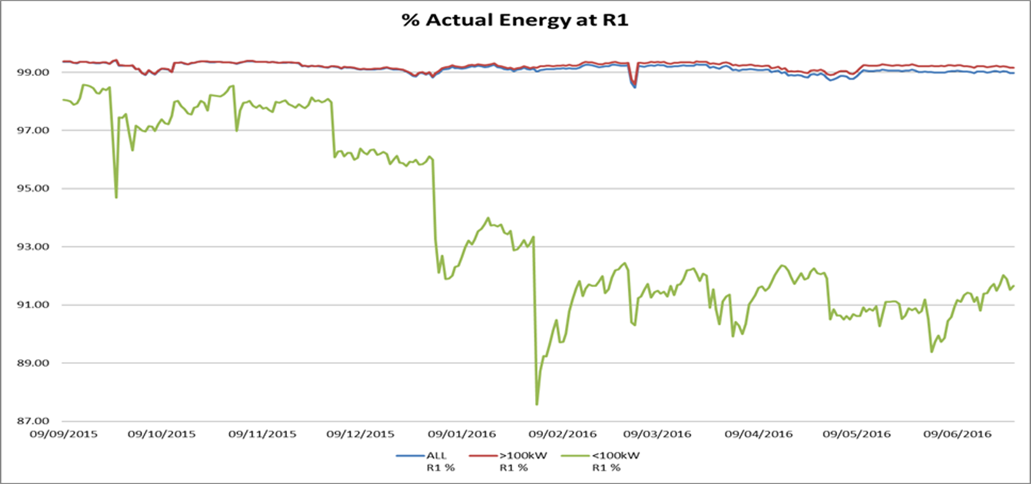
Settlement BUSRRs
Why Create a new HH Settlement Risk?

Slide 20
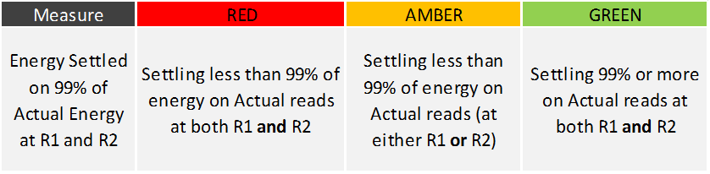
SR0081b and SR0081c
SR0081b – Sub 100kW CT Metered (Measurement Class E)

Slide 21
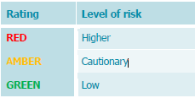


When are BUSRRs used?

Slide 22

Questions?

